Slide 1
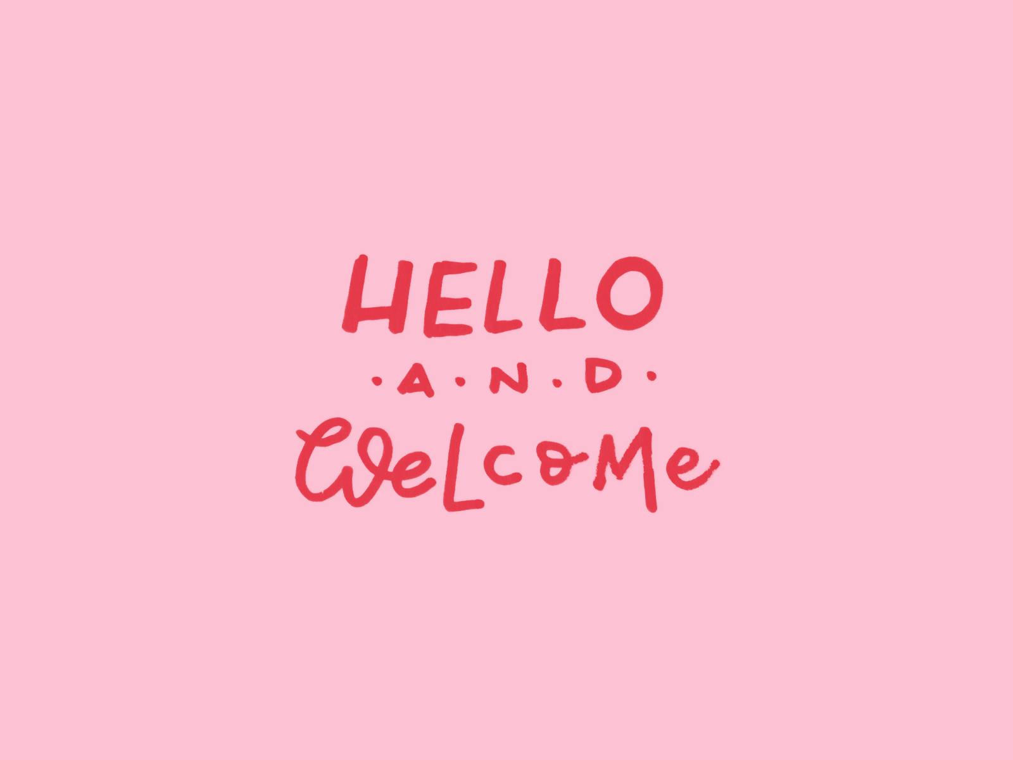

Slide 2
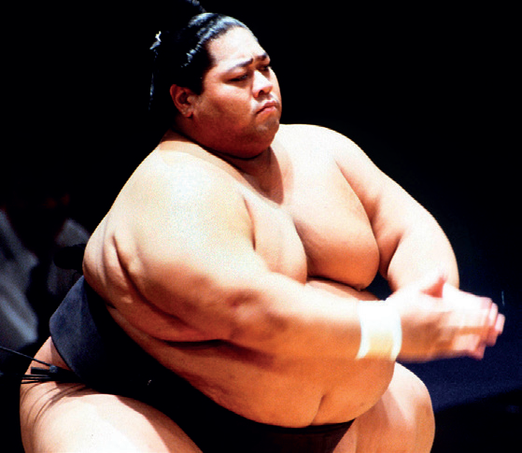
What does the man do?
What do you know about a sumo wrestler?

Slide 3
UNIT 4
food and health
Lesson 3: READING
- SUMO WRESTLERS
Page 64

Slide 4
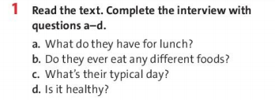
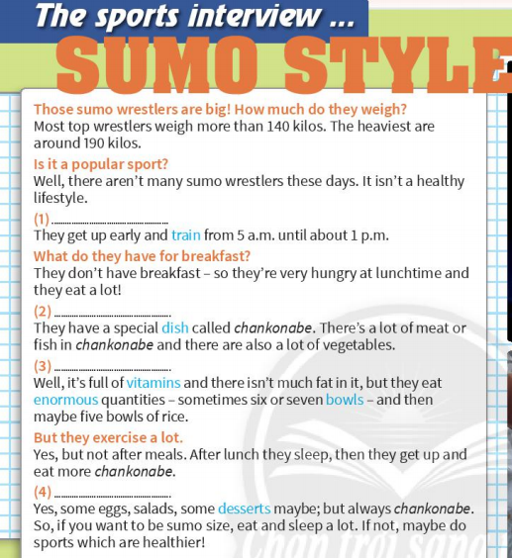
Page 64

Slide 5
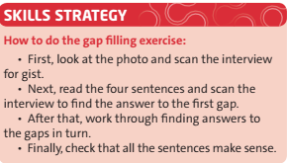

Slide 6
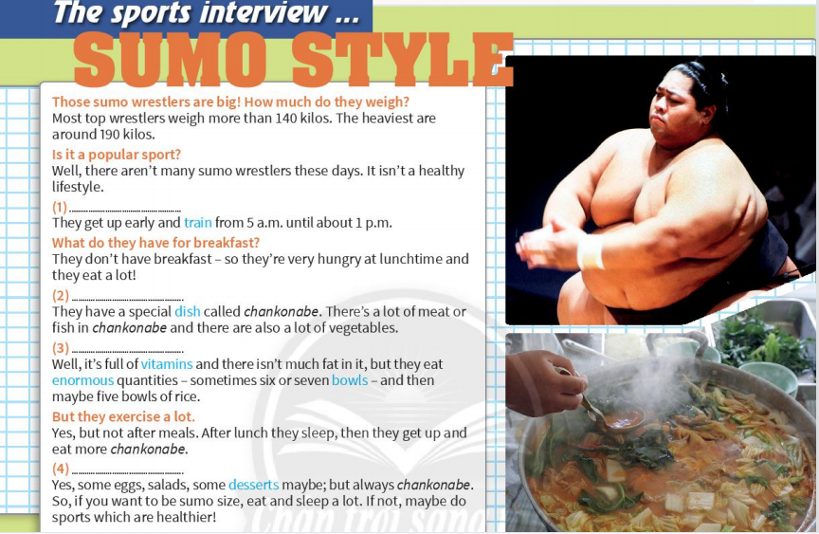
What’s their typical day?
What do they have for lunch?
Is it healthy?
Do they ever eat any different foods?

Slide 7
eat
is
before
healthy
mornings
sleep
isn’t
after
unhealthy
afternoons
The lifestyle of sumo wrestlers 1) ___________ normal. The food which they eat is 2) _______________ , but they 3) _________a lot. They also sleep a lot in the 4) ________________and they don’t exercise 5) ______________ meals.

Slide 8
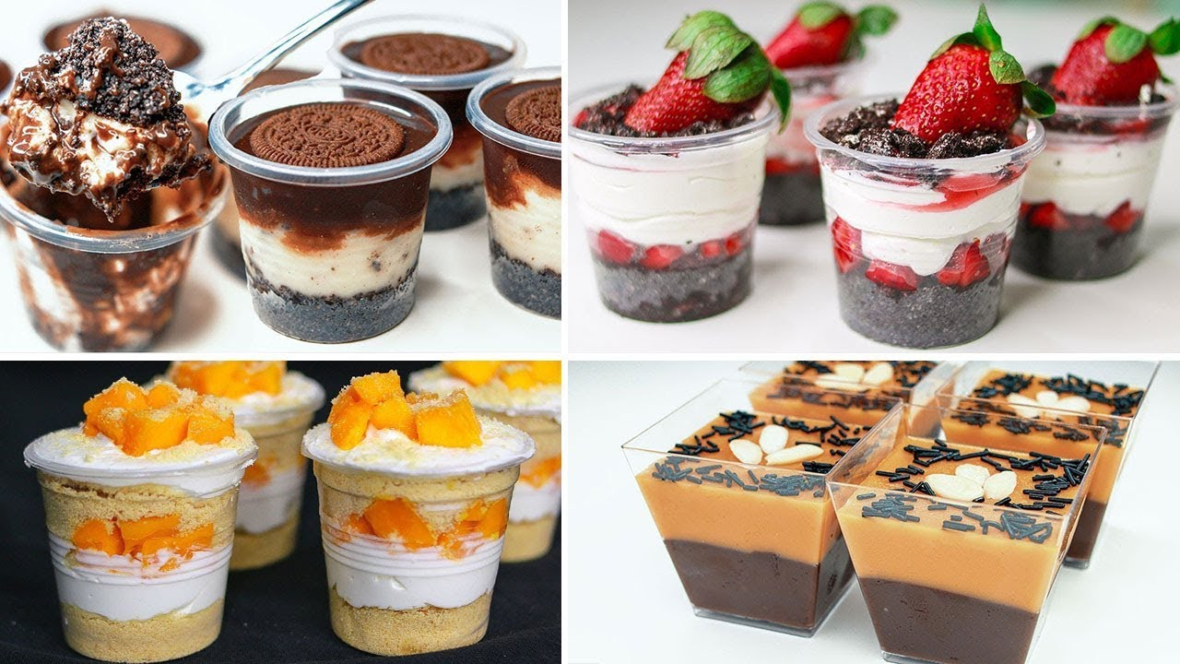
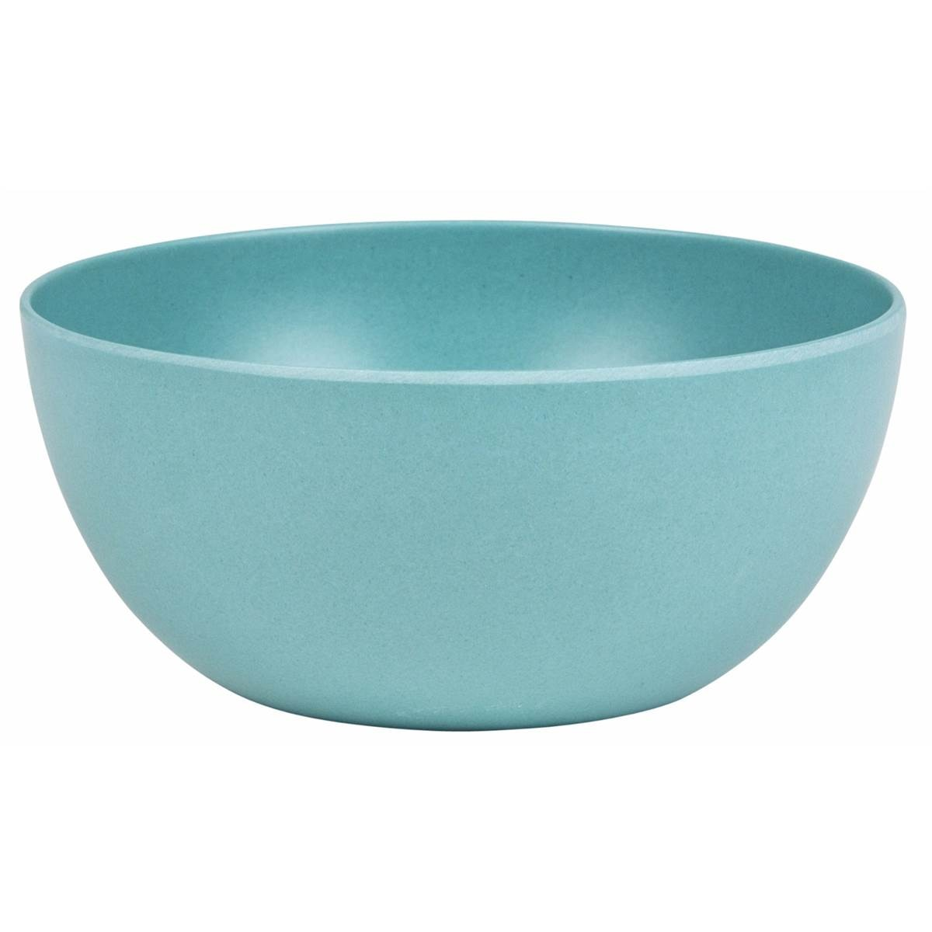
New words:
- dessert (n) /dɪˈzɜːt/
: sweet food eaten at the end of a meal
- to train (v) /treɪn/
: to exercise or to practise
Ex: I train in the gym for two hours a day.
- enormous (adj) /ɪˈnɔːməs/
: very big or huge.
Ex: Their garden is enormous.
- bowl (n) /bəʊl/
- vitamin (n) /ˈvɪtəmɪn/
: a chemical substance in food that is necessary for good health
Ex: There are lots of vitamins in vegetables.
- dish (n) /dɪʃ/
: food prepared in a particular way as part of a meal.

Slide 9
Complete the sentences with the correct blue words from the text.
Vitamins - dish - train – bowl - desserts
___________ are good for you.
Sports people usually _______ every day.
Spaghetti bolognese is a popular _________ in Italy.
You have _________ at the end of a meal.
You put rice or soup in a ________.
Vitamins
train
dish
desserts
bowl

Slide 10
TRUE – FALSE QUIZ
Most sumo wrestlers
F
1) Only the heaviest sumo wrestlers
weigh 190 kilos.
2) Sumo wrestlers start training early in the morning.
T
F
3) They
don’t have
have
a big breakfast.
F
4) There isn’t much fat
4) There’s a lot of
in chankonabe.
T
5) They sometimes eat sweet foods.

Slide 11
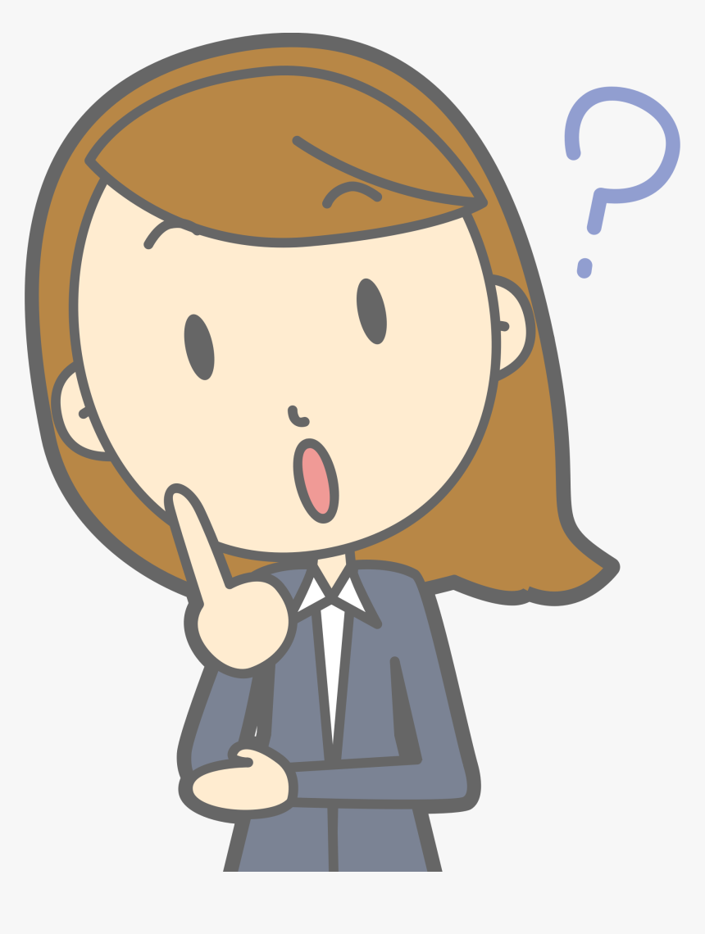
- Do you think a sumo wrestler’s life is interesting? Why / Why not?
- What is your favourite dish?

Slide 12
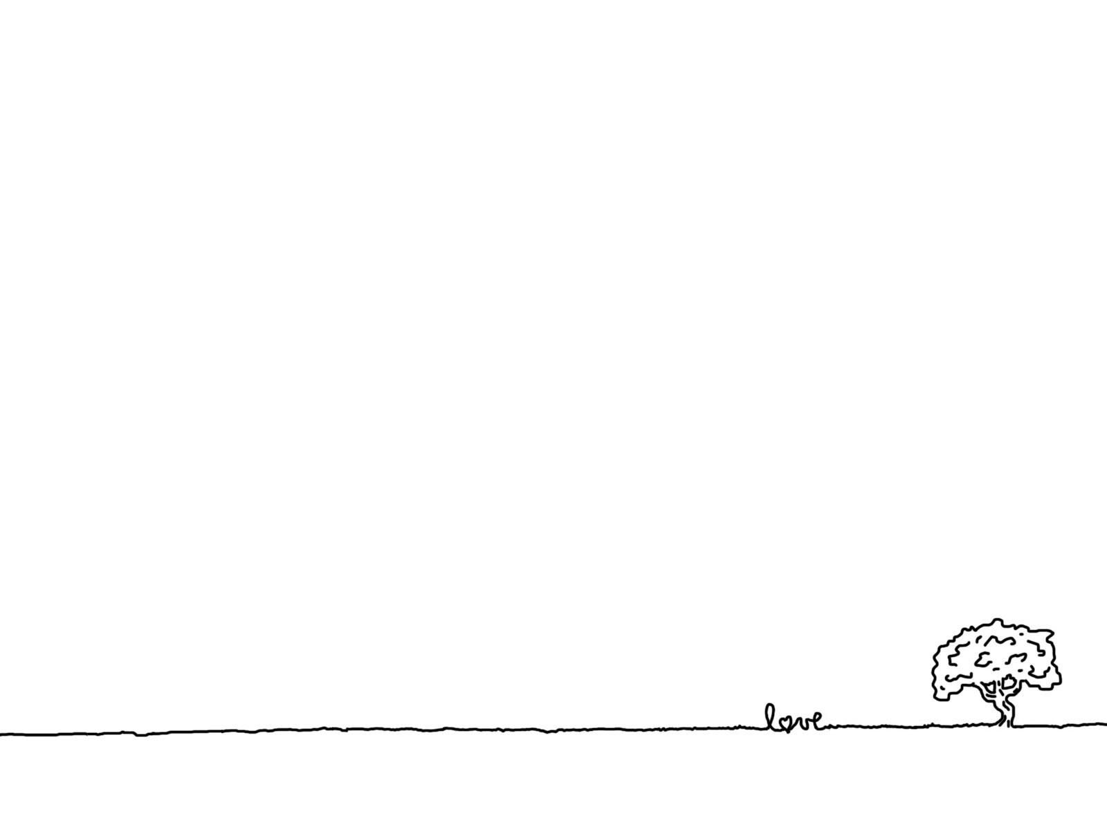
Homework
Learn by heart all the new words.
Read Skill strategy.
Workbook: exercises 1, 2/ p.40
Prepare the new lesson 4: Language focus – page 65.

Slide 14
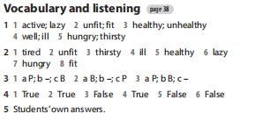
Homework
Note: file nghe của Exercise 3 and 4 Workbook.

Slide 15
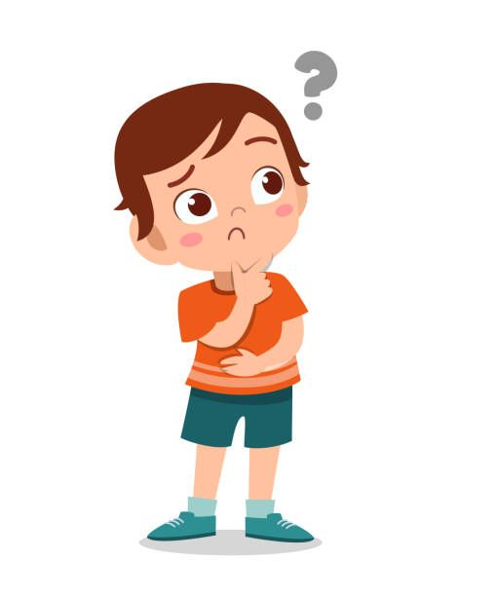
TRUE or FALSE?

Slide 16
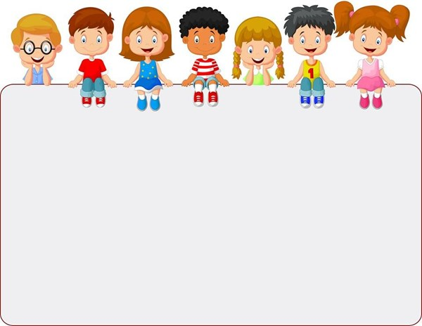
Vocabulary Plus
Use a dictionary to check the meanings of the words in blue in the text.

Slide 17
TRUE – FALSE QUIZ
Most sumo wrestlers weigh 190 kilos.
2) Sumo wrestlers start training early in the morning.
3) They have a big breakfast.
4) There’s a lot of fat in chankonabe.
5) They sometimes eat sweet foods.

Slide 18
Listen to the text again and complete the summary with five of the words in the box

